Slide 1
Low Income Multi-Family
Housing Automation
Ben Seiber, Thomas Pionk, Jheryl Lezama, Jeff Wallace, Daniel Wilmot
Notes:
Ben’s slide - Introductions

Slide 2
Sprint 4 Contributions
Ben Seiber
Fabricated logic circuits for HVAC and climate control; fabricated lighting electronics for monitoring and control.
Began integrating hardware with control software.
Created “white box” model for presentation.
Thomas Pionk
Completed Node red database connections to MySQL. Setup template MQTT communications for all future sensors..Installer admin console.
Helped fabricate the model for presentation.
Jheryl Lezama
Documentation: Activity & Sequence Diagrams, RMM Matrix, Project Plan, Gap Analysis.
Research: Website DOM Elements & NodeRed.
Jeff Wallace
Documentation: User scenarios, updated wireframe designs; landing Pages.
Database: Integration with Raspberry Pi, building tables, improving schema
Daniel Wilmot
Finalized dynamic property homepage. (Ajax, Database, PHP).
Creates image folder on registration for uploads.
Research: AJAX, PHP, JSON, JQuery for setting up property management.
Notes:
Everyone

Slide 3
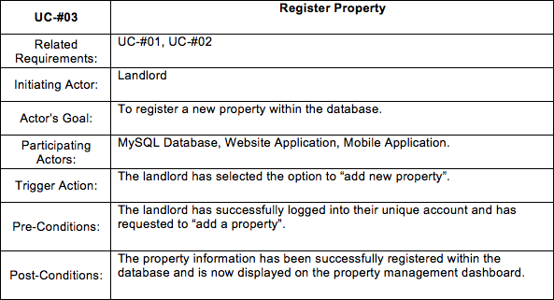
Register a Property feature
Notes:
Jheryl

Slide 4
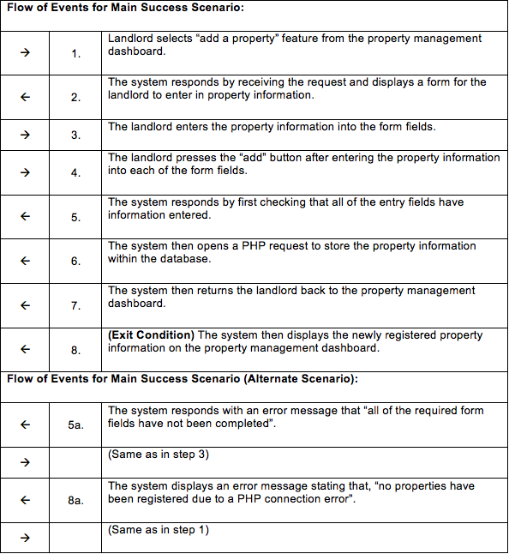
Register a Property feature (cont.)
Notes:
Jheryl

Slide 5
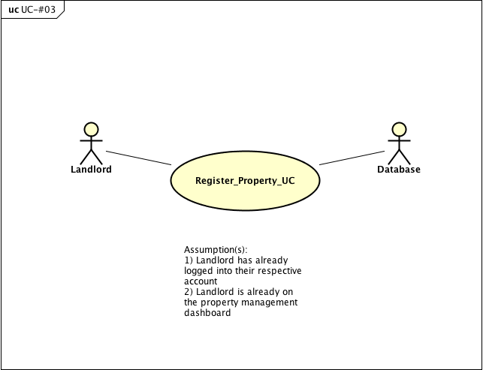
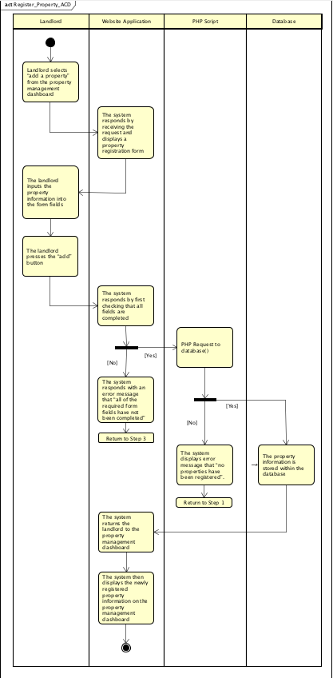
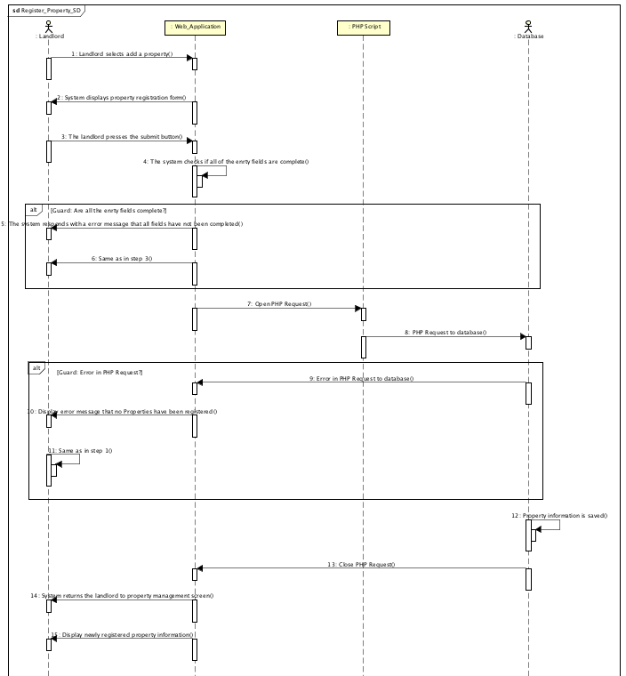
Register a Property Use Case, Activity & Sequence Diagrams
Notes:
Jheryl

Slide 6
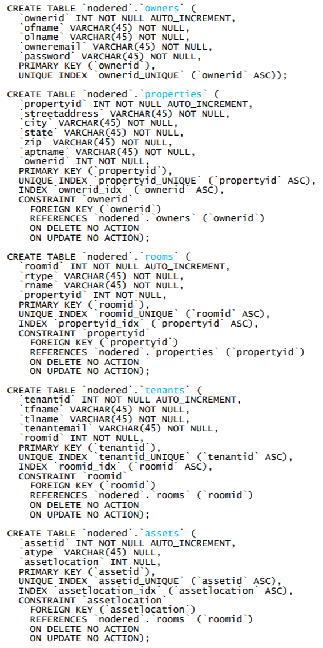
Database
Created database and tables on Raspberry Pi
Reworked the schema/ERD based on suggestions made in Sprint 3
Relation between assets and rooms
Integration with MQTT (In process)
Notes:
Jeff

Slide 7
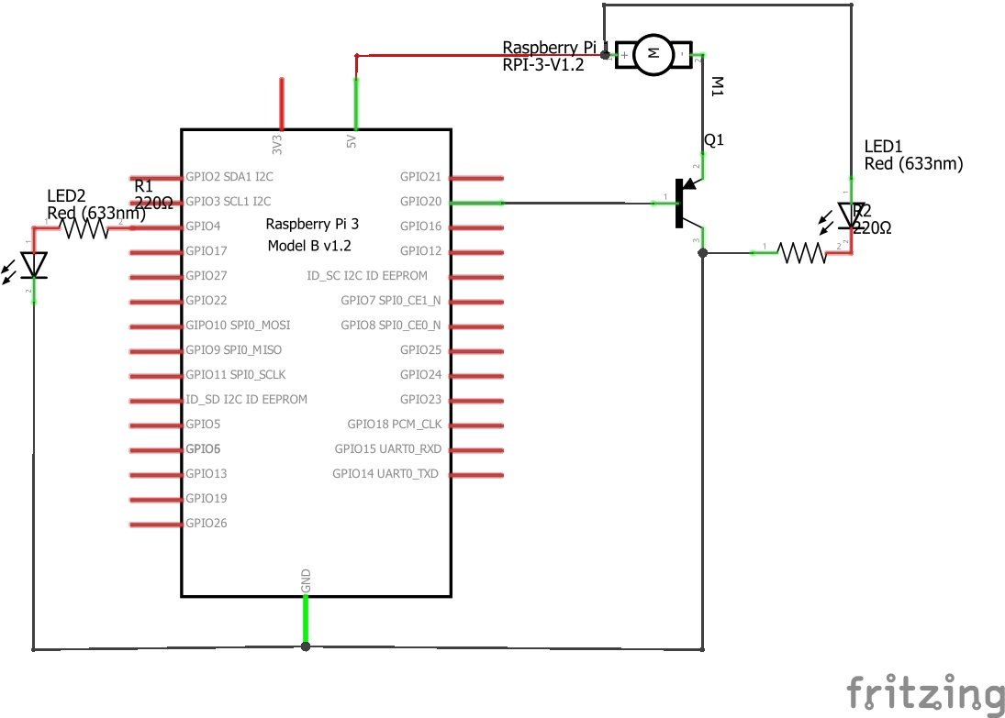
Electronics and Software Integration
Implemented the database schema onto the Raspberry Pi LAMP server
Node red controls and integration for climate control systems
Lighting control and monitoring function
Touch Screen building control interface
Notes:
Ben

Slide 8
Goals for Sprint 5
Commence with system integration consisting of Raspberry Pi server communicating with arduino sensors via MQTT and website application.
Begin work on data analytics functionality.
Notes:
Dan

Slide 9
Demo
Notes:
Danny and Ben demos

Slide 10
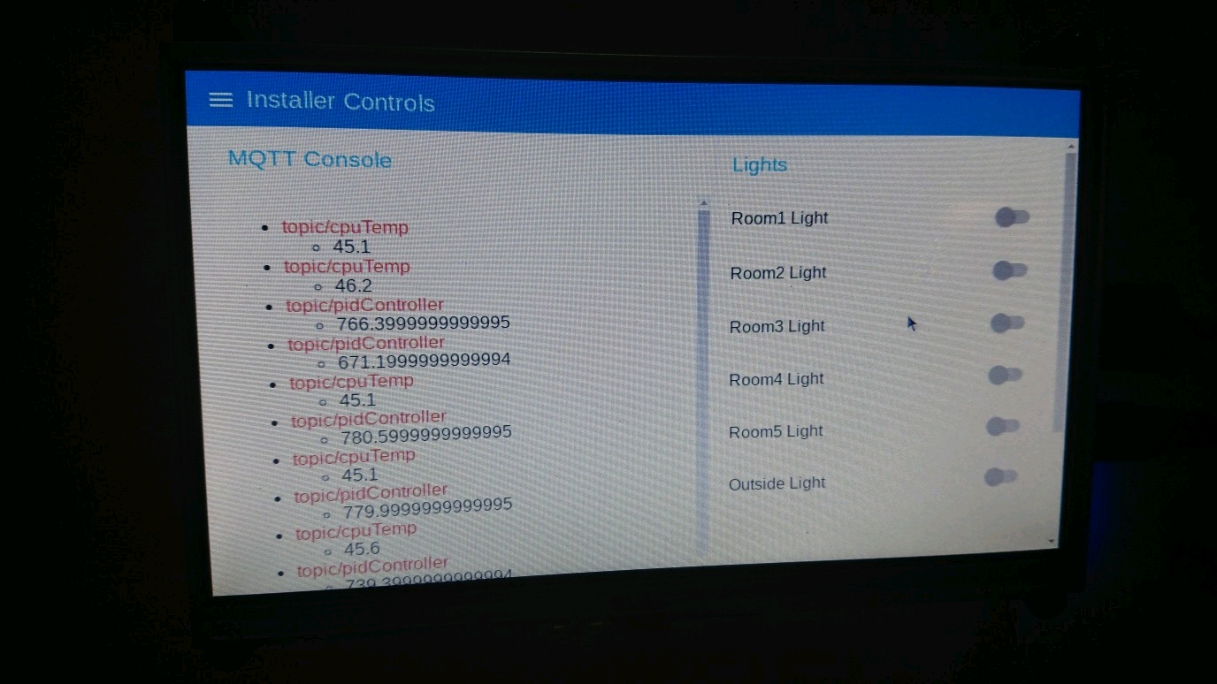
Dashboard

